Slide 1
Gganimate: Gganimating Your GGdata
Abraham Arbelaez

Slide 2
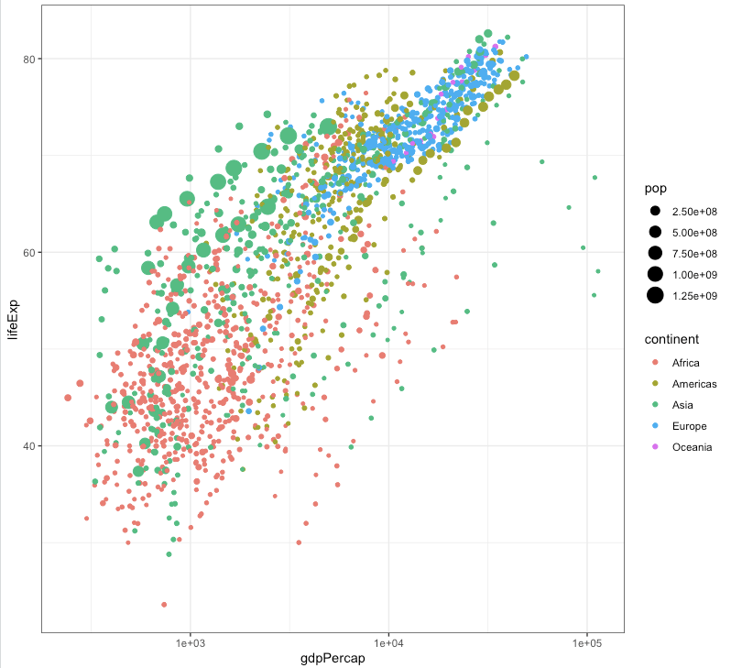
Introduction
A picture is worth a thousand words…

Slide 3
Introduction
A picture is worth a thousand words… … then a video is priceless.

Slide 4
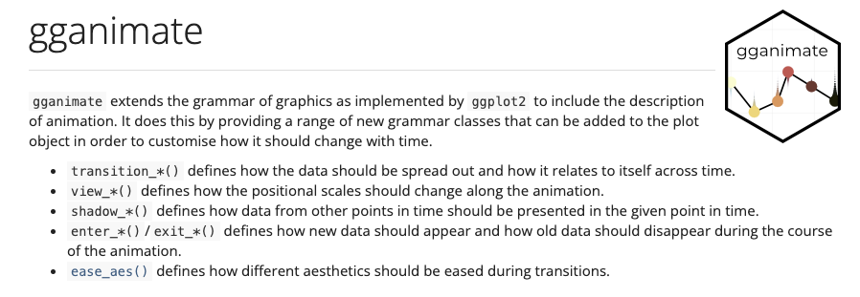
Gganimate

Slide 5
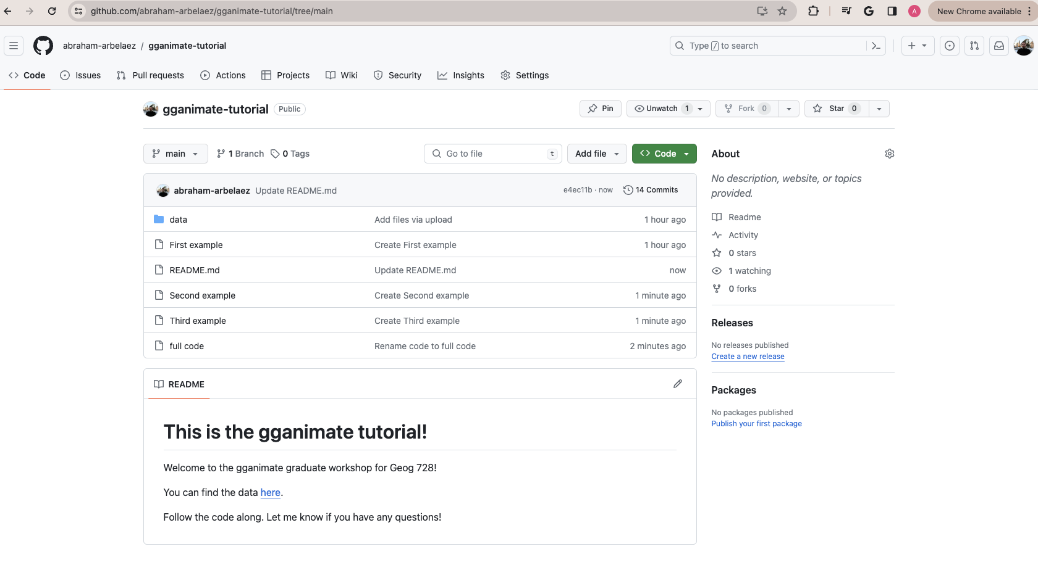
Before we get started!

Slide 6
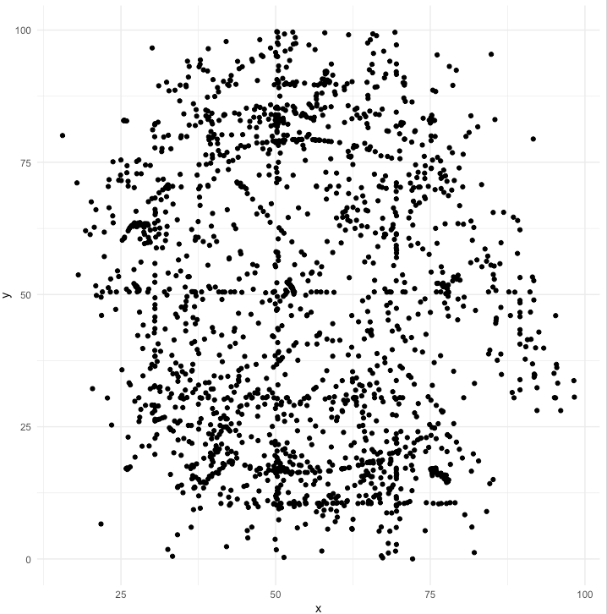
First example

Slide 7
First example

Slide 8
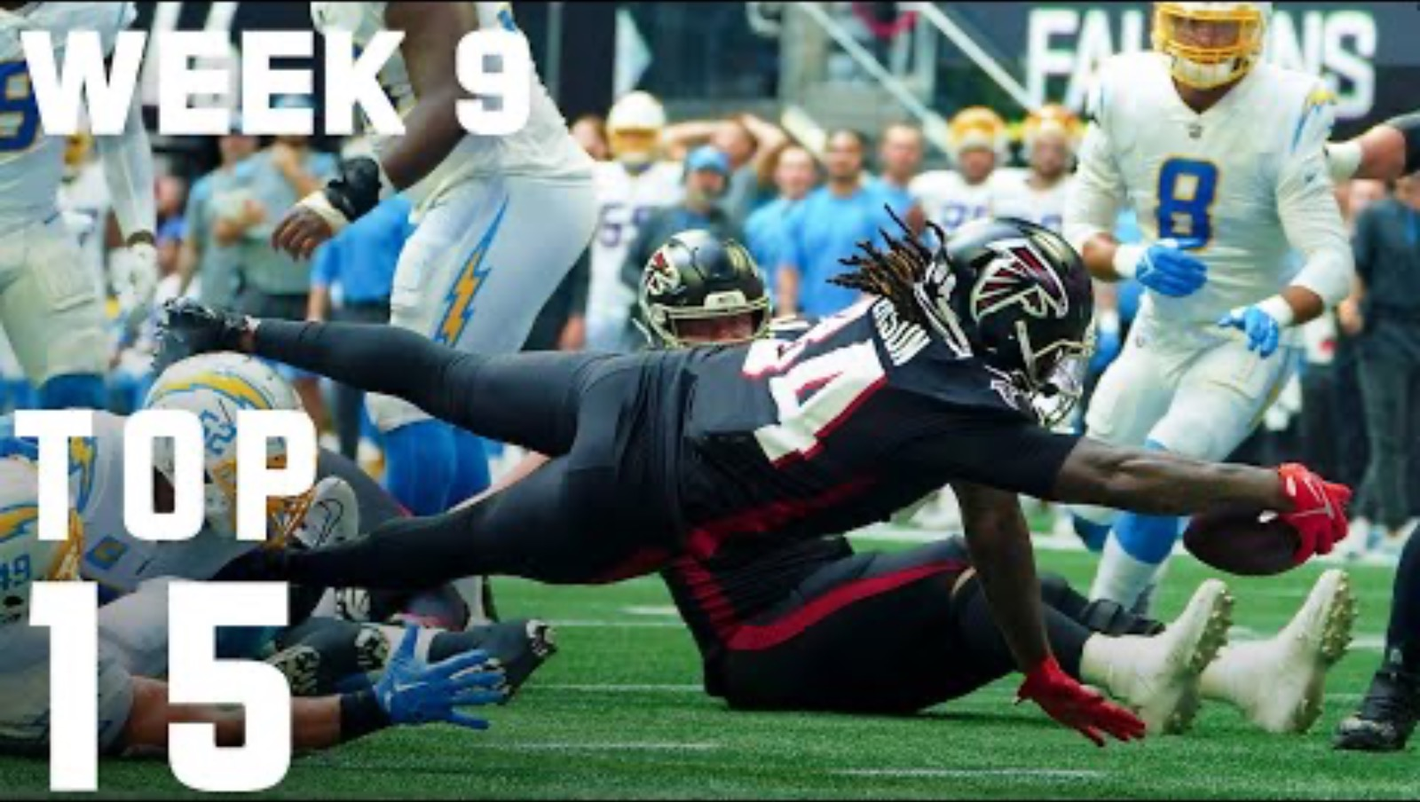
Second example

Slide 9
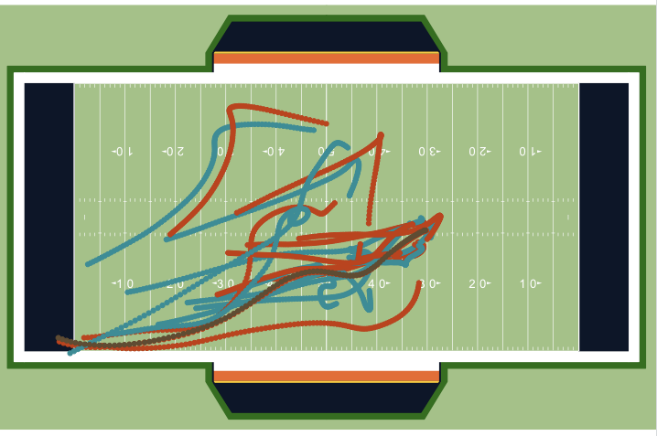
Second example

Slide 10
Second example

Slide 11
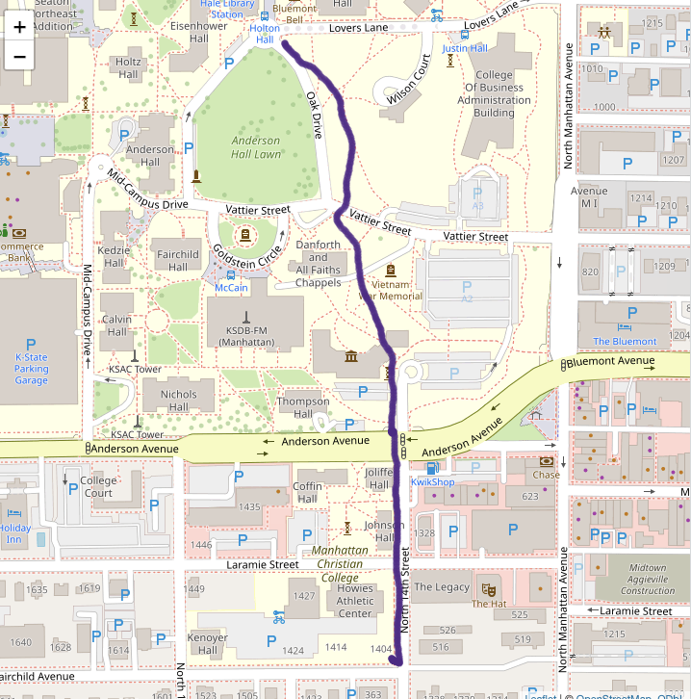
Third example

Slide 12
Third example

